Slide 1



Vehicle Loan Default Classification
Scott Fiene

Slide 2
Dataset Overview
RapidMiner was the tool of choice
41 columns
253,000 rows
Cleaning was performed in 4 stages
Automatic Feature Extraction and Engineering were turned on

Slide 3
Runs 1 & 2
Run 1
Occurred after the first stage of cleaning
41 columns and 250,000 rows
Model could create its own features
Error rate 22%
72,000 models
16,500 feature sets
934 features generated
Used 4 algorithms
Run 2
Occurred after 2nd stage of cleaning
Columns was increased from 41 to 53
All else the same

Slide 4
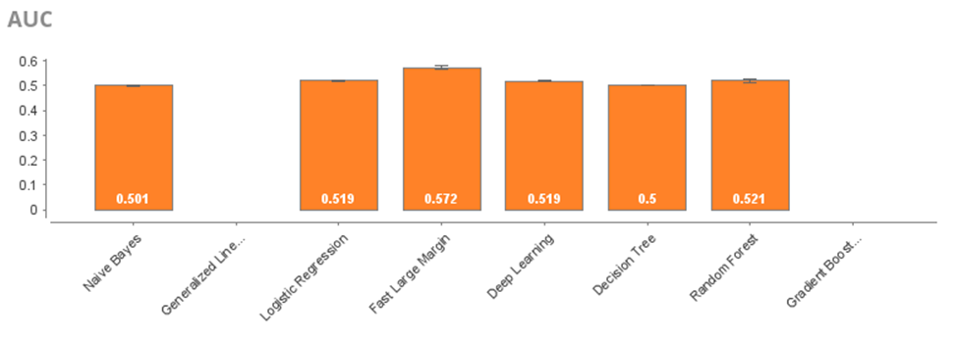
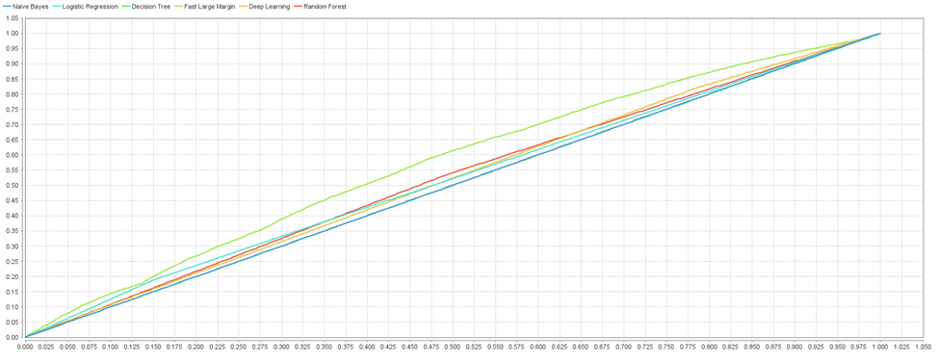
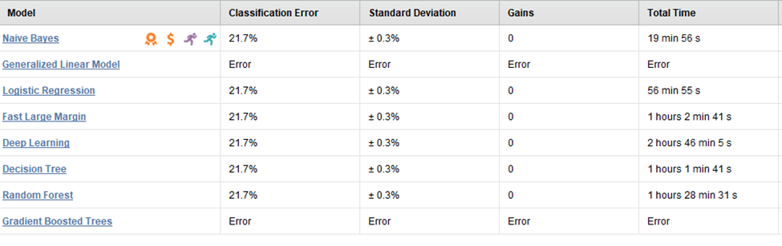
Run 3
Occurred after 3rd stage of cleaning
All values normalized
Model could create its own features
Error rate 22%
64,000 models created
17,000 feature sets
6 algorithms used

Slide 5
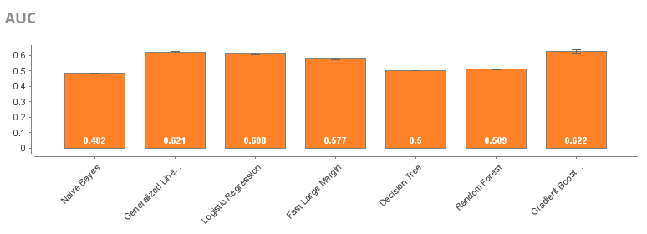
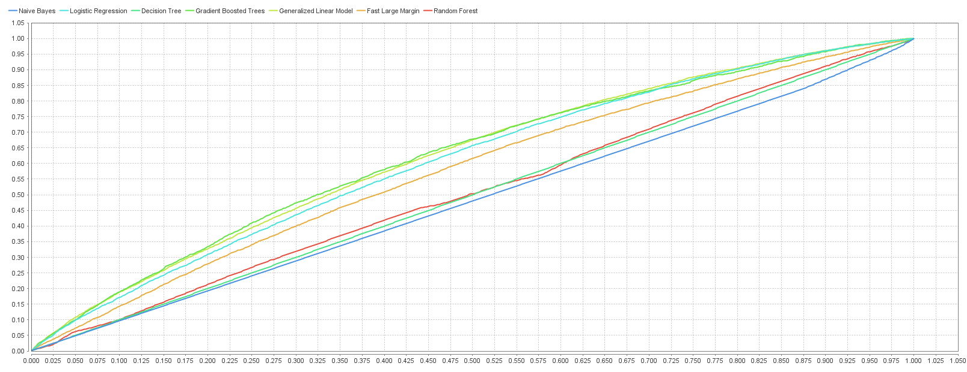
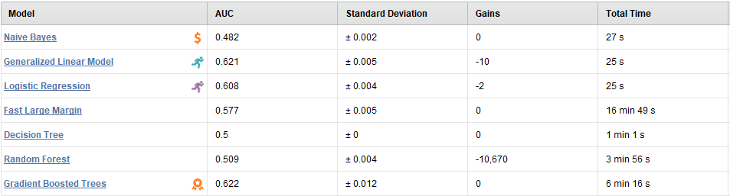
Occam’s Razor
This was the last run of the data and it was the simplest. It was surprisingly the most accurate also

Slide 6


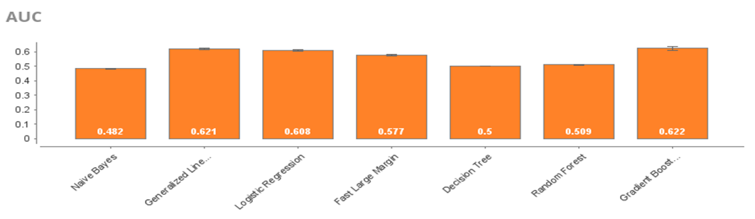
Run 3 vs. Run 5

Slide 7
Recommendations
When querying data out of a database, make sure that it is flattened
Have one right method for entering data such as dates and text values
Store the date in a neater format so that it is easier to extract

